Slide 1



Riemannian Multinomial Logistics Regression for SPD Neural Networks – CVPR 2024 –
Ziheng Chen¹, Yue Song¹, Gaowen Liu², Ramana Rao Kompella², Xiaojun Wu³, Nicu Sebe¹
1 University of Trento, Italy
2 Cisco Systems, USA
3 Jiangnan University, China

Slide 2
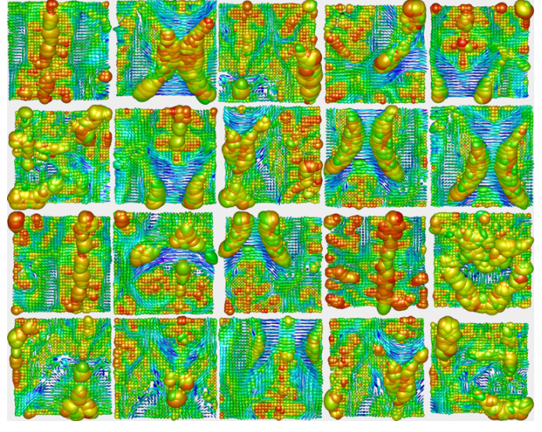
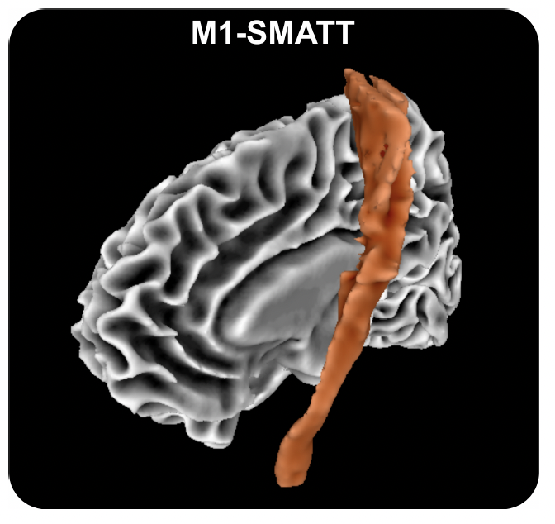
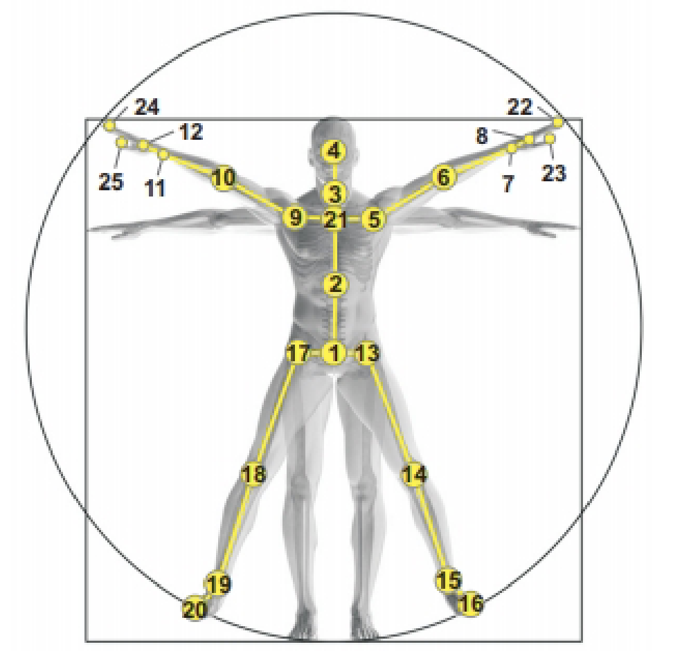
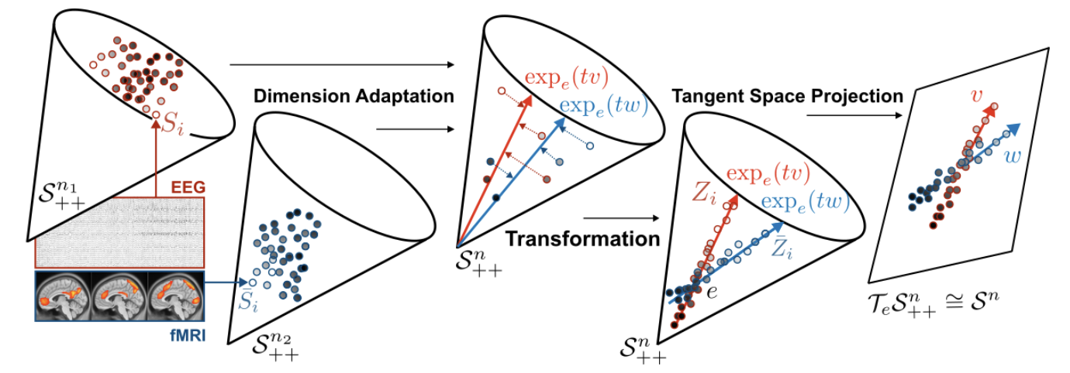
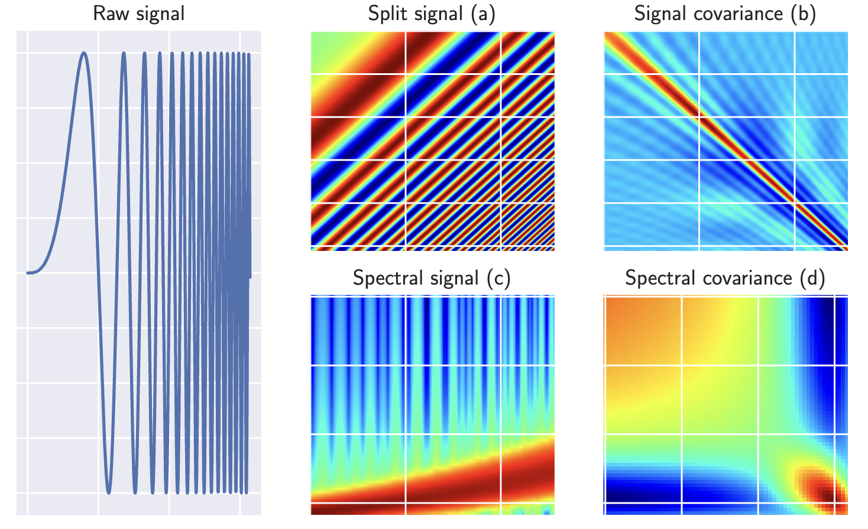
Applications of SPD Manifolds
Image generation
Medical Imaging
Action Recognition
Huang et al., 2019
Chakraborty et al., 2020
Nguyen, Xuan Son 2021
Brain-Computer Interfaces
Radar Classification
Ju et al., 2024
Brooks et al., 2020
Huang, Zhiwu, Jiqing Wu, and Luc Van Gool. "Manifold-valued image generation with wasserstein generative adversarial nets." AAAI, 2019.
Chakraborty, Rudrasis, et al. "Manifoldnet: A deep neural network for manifold-valued data with applications." IEEE-TPAMI, 2020.
Ju, Ce, et al. "Deep geodesic canonical correlation analysis for covariance-based neuroimaging data." ICLR, 2024.
Nguyen, Xuan Son. "Geomnet: A neural network based on riemannian geometries of SPD matrix space and cholesky space for 3D skeleton-based interaction recognition." ICCV, 2021.
Brooks, Daniel, et al. "Deep learning and information geometry for drone micro-Doppler radar classification." RadarConf, 2020.

Slide 3
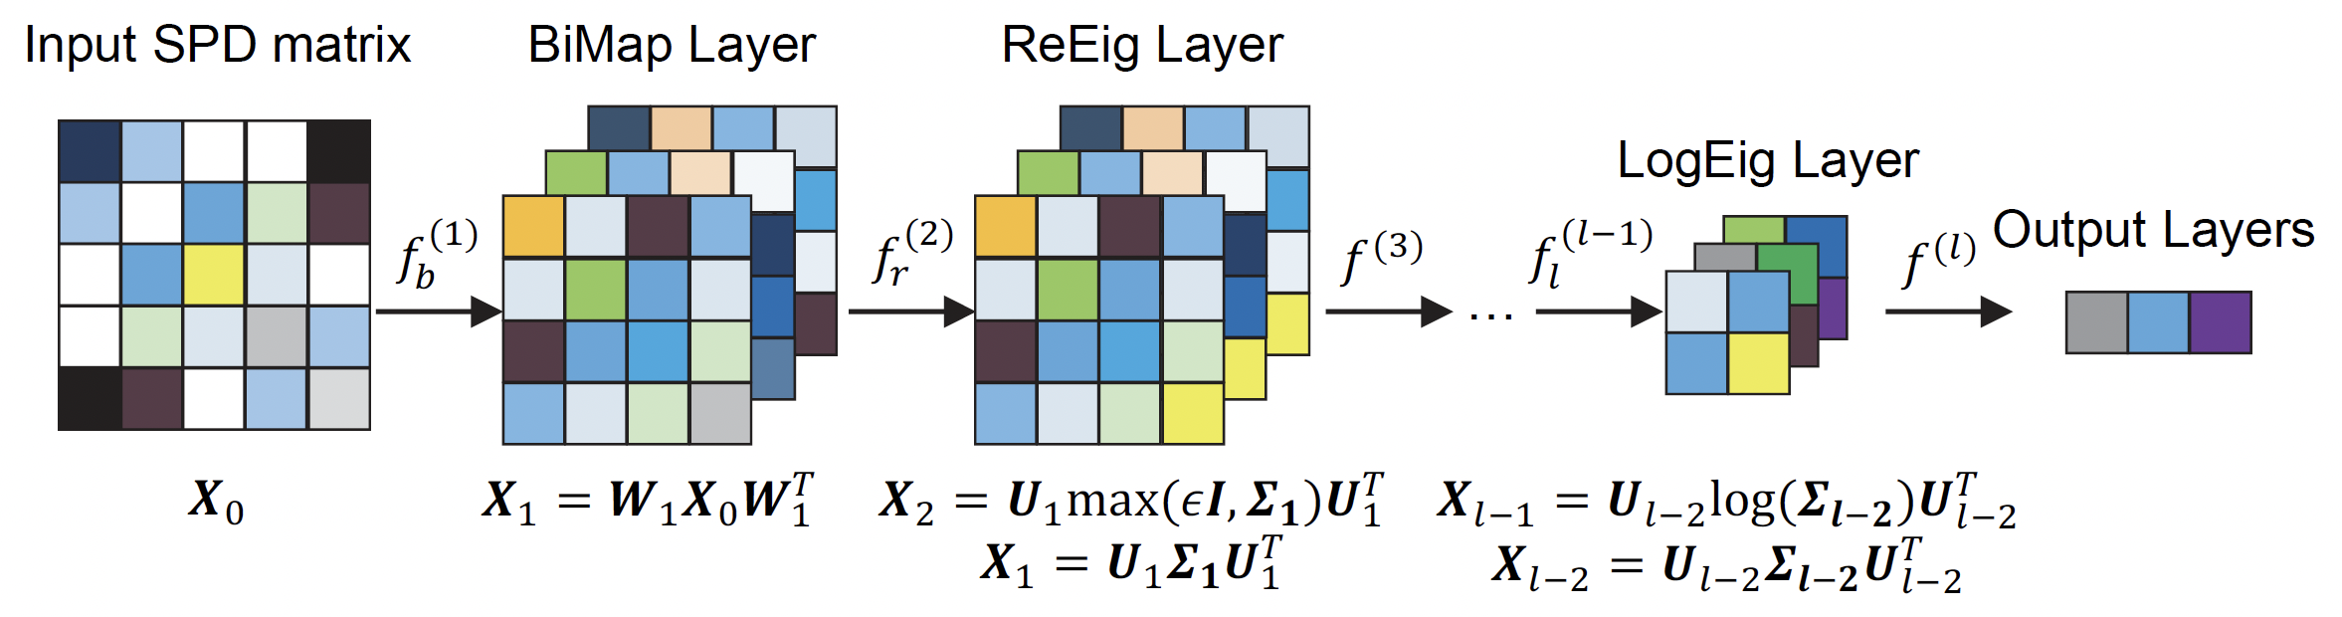
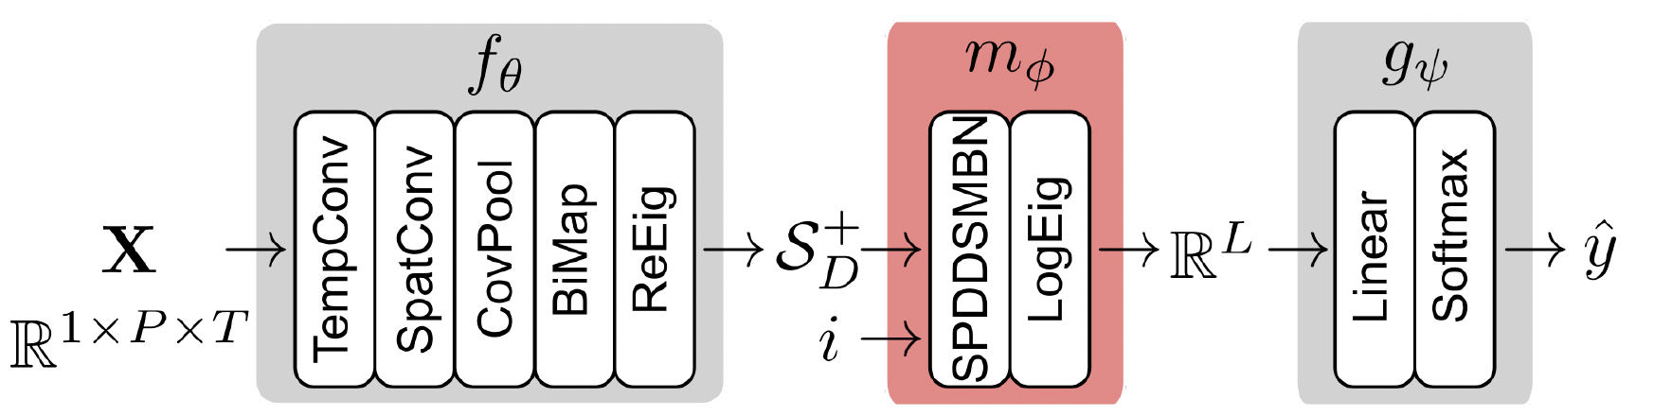
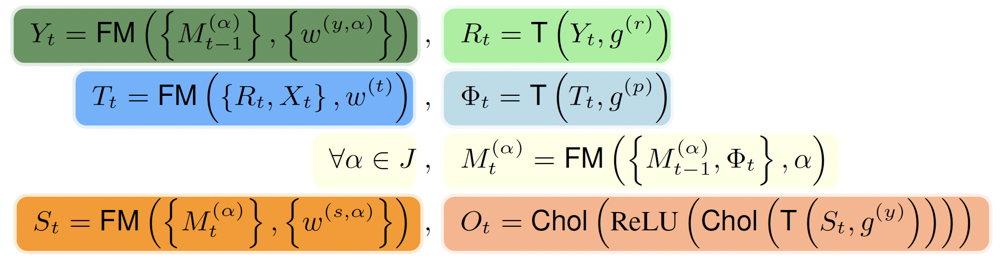
Classification on SPD Neural Networks
Tangent Space:
SPDNet (Huang et al., 2017)
TSMNet (Kobler et al., 2022)
Parameterization:
SPD-SRU (Chakraborty et al., 2018)
They rely on approximated spaces
How to build intrinsic classification layers on manifolds?
Huang, Zhiwu, and Luc Van Gool. "A riemannian network for spd matrix learning." AAAI, 2017.
Kobler, Reinmar, et al. "SPD domain-specific batch normalization to crack interpretable unsupervised domain adaptation in EEG." Neurips, 2022.
Chakraborty, Rudrasis, et al. "A statistical recurrent model on the manifold of symmetric positive definite matrices." Neurips, 2018.

Slide 4
Contributions
SPDMLR:
A general framework for SPD Multinomial Logistics Regression (MLR) under PEMs
Specific SPD MLRs under parameterized LCM and LEM
An intrinsic theoretical explanation of the most popular LogEig classifier

Slide 5



MLR Revisiting
Euclidean MLR:
Reformulation into margin distance to hyperplane
Gyro SPD MLR:
Requires gyro vector structures
Relies on gyro distance, instead of geodesic distance
Solves formulation case by case
Our SPD MLR:
Focus on Pullback Euclidean Metrics (PEMs)
Only needs Riemannian geometry
Relies on geodesic distance
Proposes a general formulation for PEMs
Nguyen, Xuan Son, and Shuo Yang. "Building neural networks on matrix manifolds: A Gyrovector space approach." ICML, 2023.

Slide 6
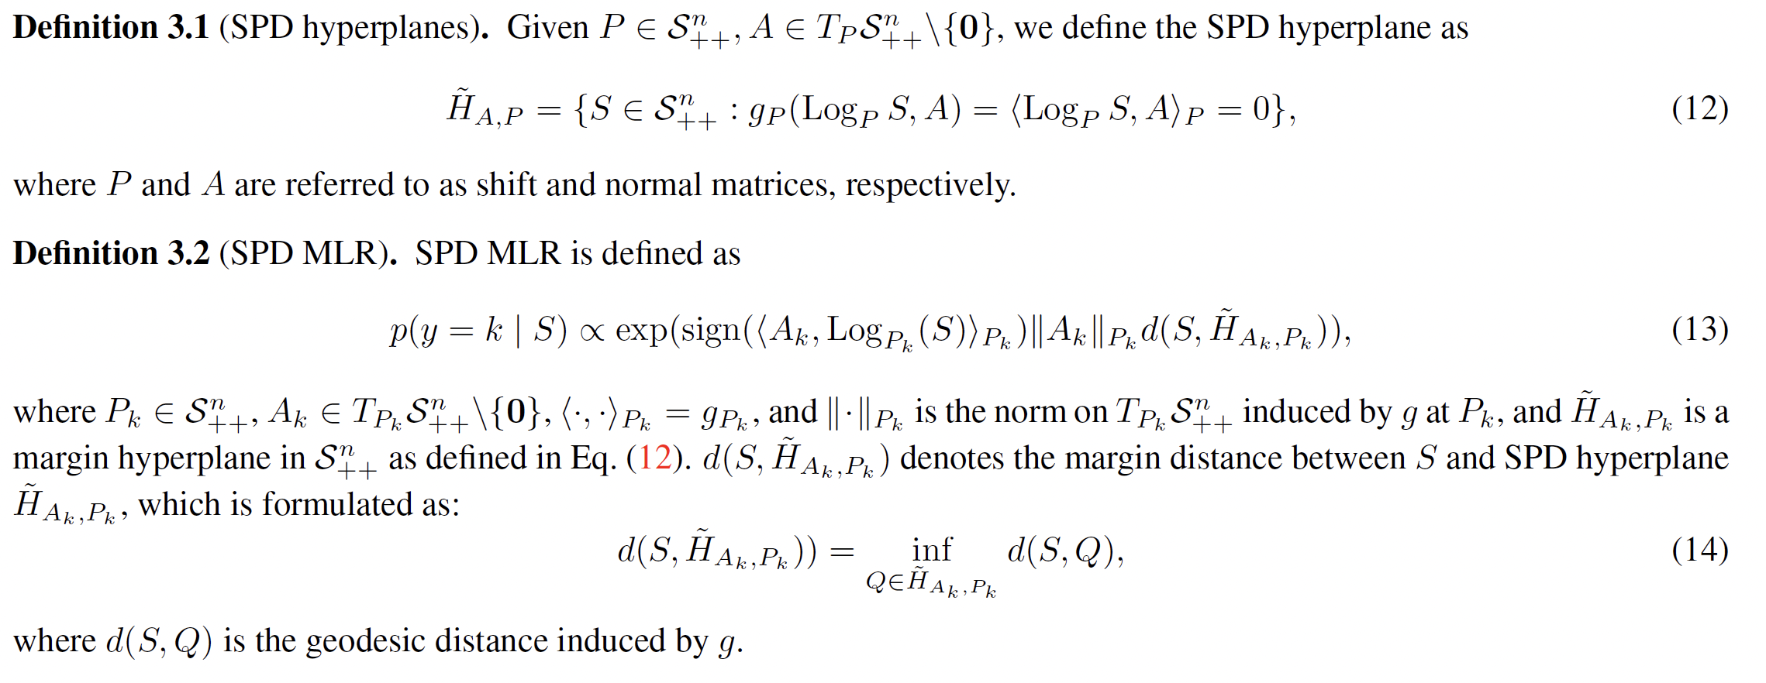

SPD MLR under PEMs
From Euclidean to SPD
Riemannian reformulation
Submanifolds are natural generalizations of the Euclidean hyperplanes.

Slide 7
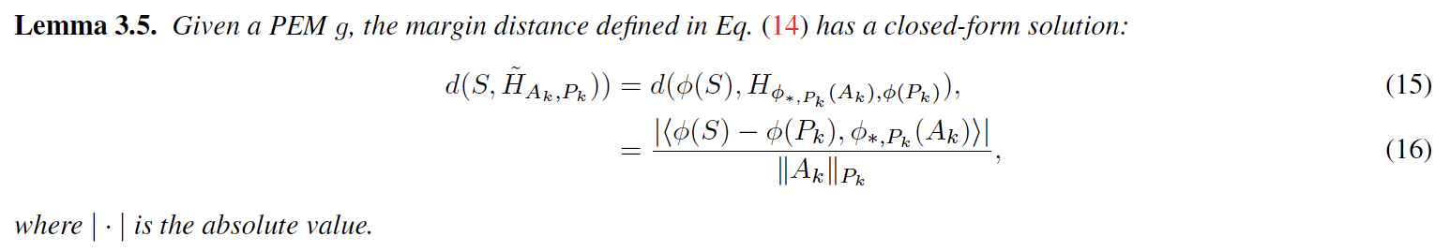

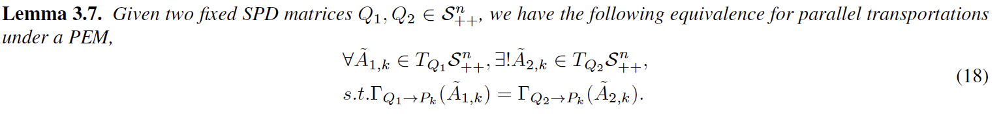
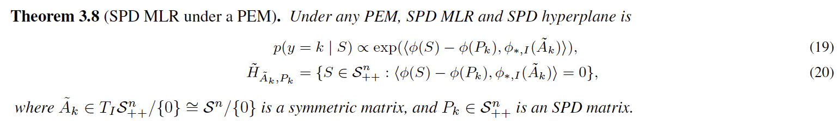
SPD MLR under PEMs
Margin distance and MLR
Margin distance:
Optmization:
General formulation:

Slide 8
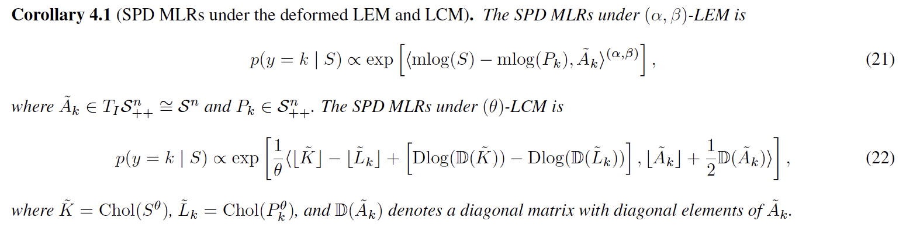
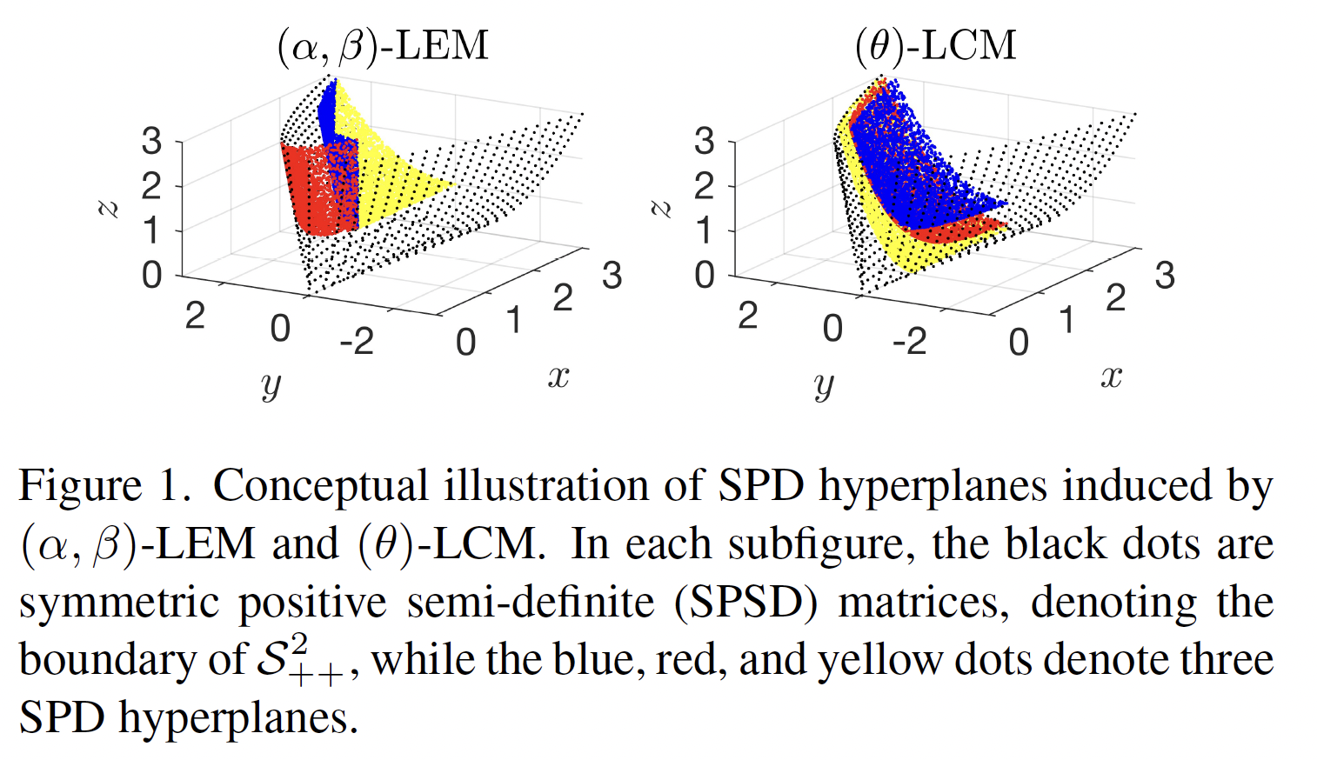
MLR on the parameterized LEM and LCM
Visualization of SPD hyperplane

Slide 9

An Intrinsic explanantion for LogEig MLR
Tangent Space:
SPDNet (Huang et al., 2017)
TSMNet (Kobler et al., 2022)
LogEig MLR respects a Riemannian MLR

Slide 10
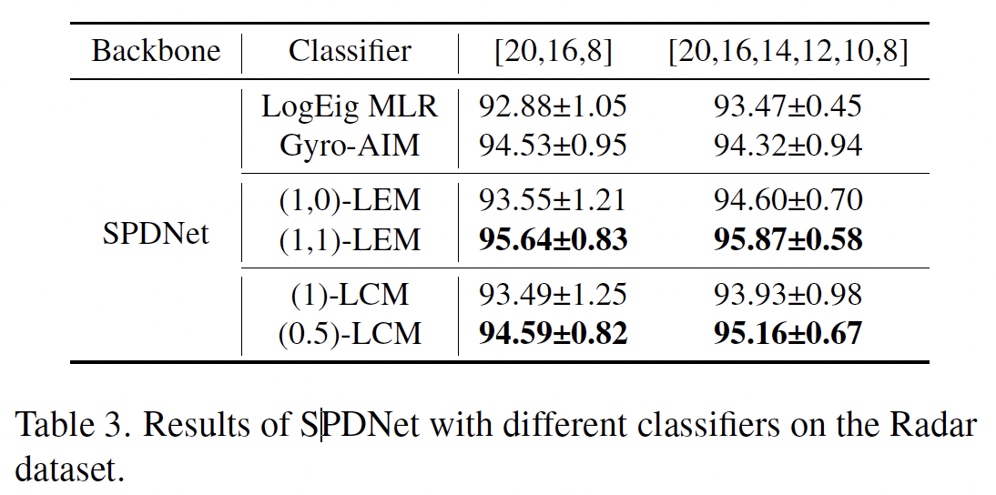
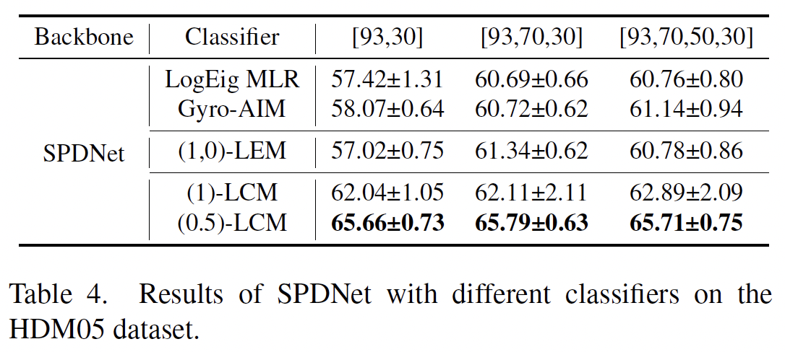
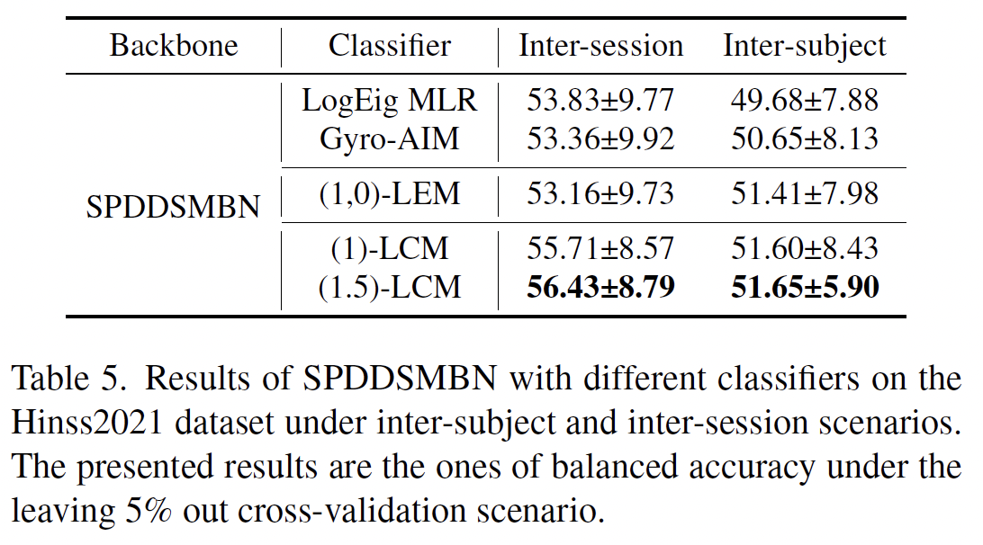
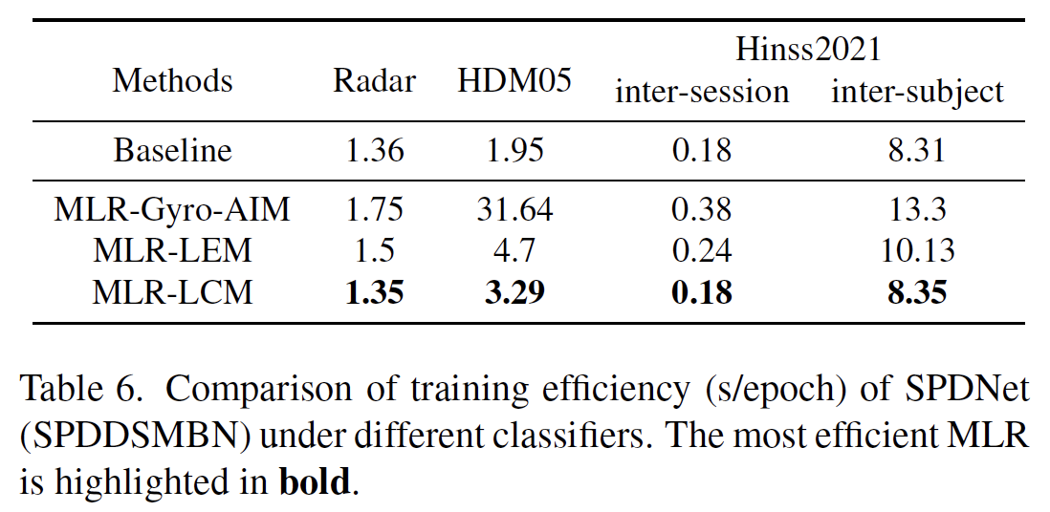
Experiments
Huang, Zhiwu, and Luc Van Gool. "A riemannian network for spd matrix learning." AAAI, 2017.
Kobler, Reinmar, et al. "SPD domain-specific batch normalization to crack interpretable unsupervised domain adaptation in EEG." Neurips, 2022.

Slide 11



Thanks you
Q & A
Q & A
Code
Paper
Homepage

